Slide 1
IntelliMeet Pro
AI Meeting Assistant & Workflow Management
Final Defense Presentation
Mustafa Masood (22k-4818)
Laiba Fatima (22k-5195)
Supervisor: Ms. Rubab Jaffar

Slide 2



Introduction
The Meeting Challenge
Meetings are essential but often inefficient. With remote work, digital platforms generate vast conversational data.
Inefficient Processes
Traditional note-taking fails to capture data reliably, leading to missed action items and unclear decisions.
Digital Data Overload
Massive amounts of conversational data produced by platforms like Zoom, Google Meet, and Microsoft Teams.
Poor Follow-up
Resulting in poor follow-up and lack of structured knowledge from meetings.
IntelliMeet Pro
Page 2 of 11

Slide 3
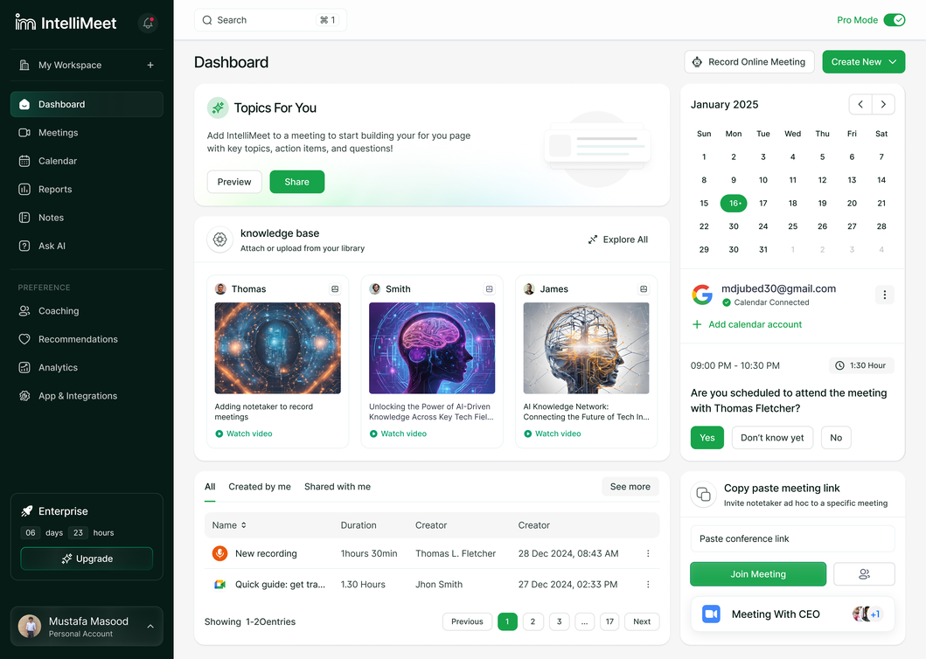



IntelliMeet Pro Overview
The Solution
IntelliMeet Pro is an AI-powered meeting assistant and workflow management platform designed to transform meeting productivity.
Autonomous Participation
AI assistant participates, transcribes, and semantically summarizes meetings.
Workflow Management
Direct integration with project management tools for seamless follow-up.
Intelligent Knowledge Layer
Leverages NLP, speaker diarization, and vector-based semantic search.
IntelliMeet Pro
Page 3 of 11

Slide 4








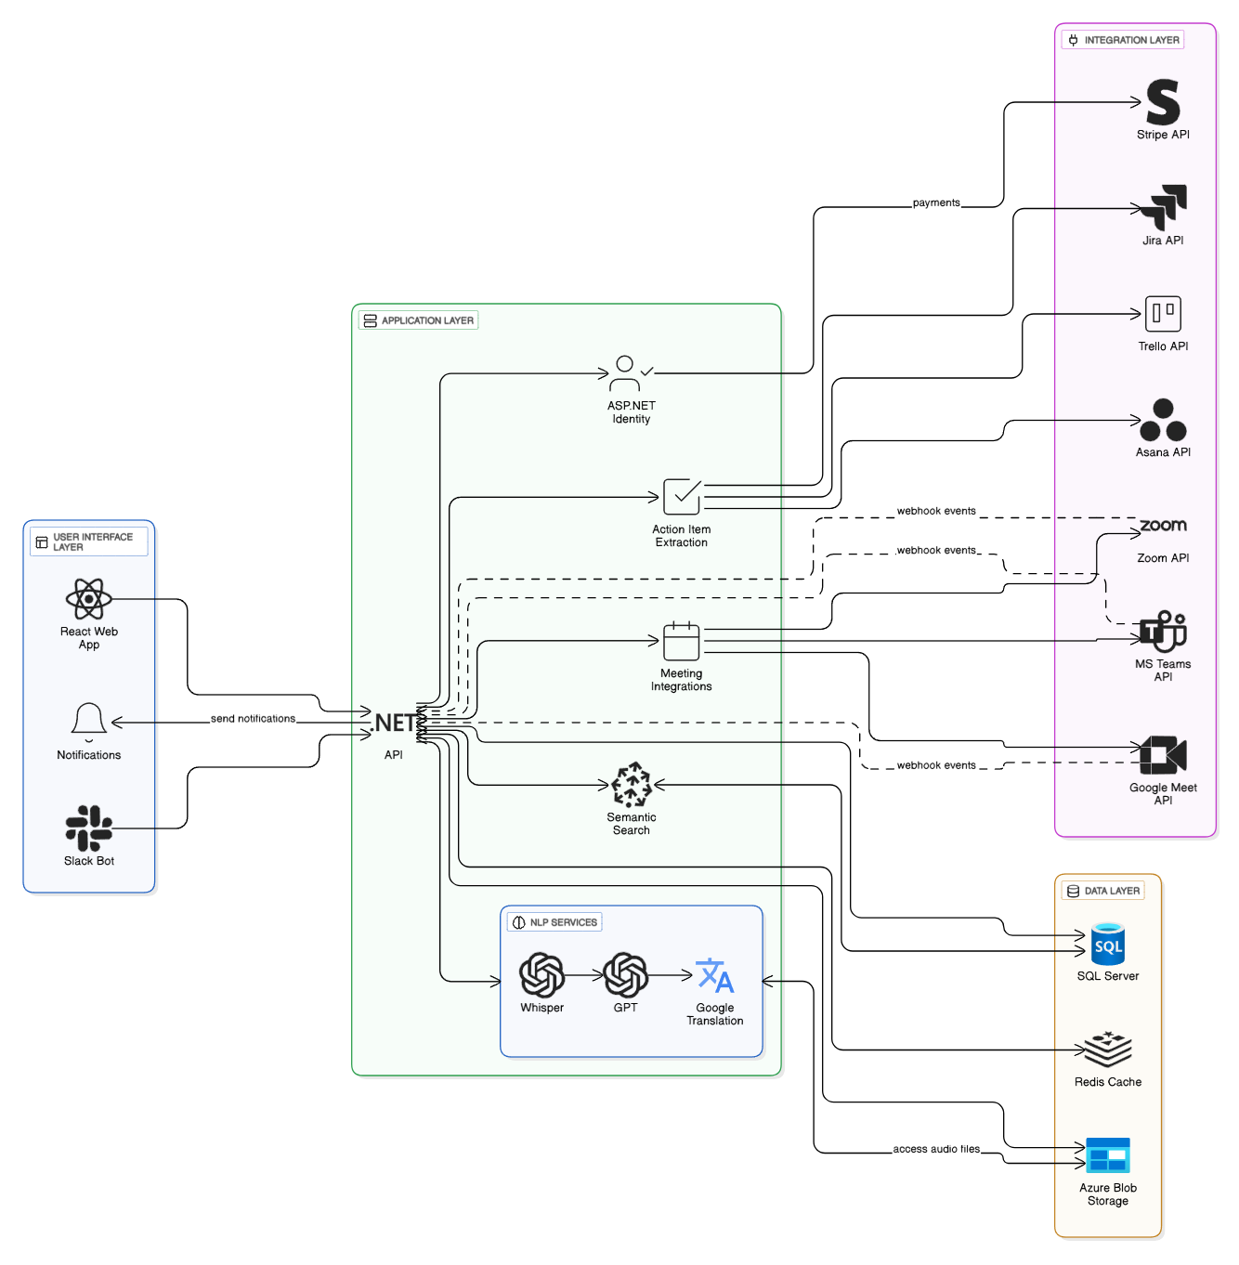

FYP-I Deliverables
Requirements Analysis
System Design
Project proposal document
Approved Software Design Specification (SDS)
Feasibility study report
Database schema and ERD diagrams
Approved Software Requirements Specification (SRS)
System architecture diagrams
UI/UX wireframes and mockups
Initial technology stack selection
API documentation templates
Planning & Implementation Strategy
Definition of modules, resource allocation, tool selection, and technology stack validation.
IntelliMeet Pro
Page 4 of 11

Slide 5




Current Status (FYP-I)
Core Modules Implemented & Tested
As of December 2025, the following core modules have been successfully implemented and tested, forming the foundation for FYP-II.
Speech-to-text Transcription
Speaker Diarization
Using Whisper API for accurate transcription.
Identification and separation of speakers.
AI-powered Summarization
Action Item Extraction
Leveraging GPT-4 for concise summaries.
With assignee attribution for clear tasks.
IntelliMeet Pro
Page 5 of 11

Slide 6


System Architecture
4-Layered Architecture Model
IntelliMeet Pro adopts a robust 4-layered architecture, ensuring modularity, scalability, and maintainability for an enterprise-ready system.
Presentation Layer (Frontend UI/UX)
Application Layer (Business Logic)
Data Layer (Persistence & Storage)
Integration Layer (External Services/APIs)
IntelliMeet Pro
Page 6 of 11

Slide 7





System Architecture
Deep Dive: Architectural Layers
Presentation Layer
Application Layer
Built with React, TypeScript, TailwindCSS 4, Shadcn UI. Handles UI, dashboards, search, transcripts, summaries.
Developed using ASP.NET Core 8.0. Manages transcription, summarization, diarization, and workflow automation.
Data Layer
Integration Layer
SQL Server for structured data, Azure Blob Storage for audio, Pinecone Vector DB for semantic embeddings.
Handles third-party interactions: OpenAI, Jira, Trello, Asana, Slack Bot, Stripe, Google Translation, Zoom/Meet/Teams APIs.
IntelliMeet Pro
Page 7 of 11

Slide 8




Testing & Results
Validation of Core AI Components
During FYP-I, the primary objective was to validate the technical feasibility of IntelliMeet Pro’s core AI components.
Modules Tested:
Transcription (OpenAI Whisper API)
Speaker Diarization Feasibility
Summary Generation (OpenAI GPT)
Action Item Extraction (OpenAI GPT)
Key Takeaways Identification (OpenAI GPT)
IntelliMeet Pro
Page 8 of 11

Slide 9
Testing & Results
Key Testing Outcomes
Transcription Accuracy
Speaker Diarization
High-quality mic: 94–96%
Laptop mic: 91–93%
Background noise: 88–91%
Whisper’s segmentation reasonable. Accuracy 70–80% for short clips. Hybrid approach needed for consistent profiles.
Summary Generation (GPT-4)
Action Items & Key Takeaways
High relevance, excellent structure, appropriate conciseness. 90–95% accurate to transcript content.
Task identification: 85–92%.
Assignee detection: 80–88%.
Key takeaways consistently clear and high-level.
IntelliMeet Pro
Page 9 of 11

Slide 10



FYP-II
Goals for FYP-II
Backend Implementation
Comprehensive Testing & QA
Develop complete ASP.NET Core 8.0 API
Implement semantic search pipeline with Pinecone
Integrate Jira, Trello, Asana synchronizations
Develop Slack bot capabilities
Implement secure subscription system via Stripe
Conduct unit, integration, system, and performance testing
Test AI pipeline latency and accuracy
Validate cross-platform bot deployment reliability
Check subscription limits and access controls
Conduct UAT with real users
Deployment
Final Deliverables
Deploy backend to Azure App Services
Deploy database to Azure SQL
Set up Azure Blob Storage for audio
Deploy frontend to Vercel/Azure Static Web Apps
Fully functioning IntelliMeet Pro platform
Technical manual and user documentation
Final thesis/report
FYP-II presentation and open house demonstration
IntelliMeet Pro
Page 10 of 11

Slide 11
THANK YOU!

